Slide 1

TranzVolt 2.0
Survance | Jia | Jang | Bunner | baek | Yerramilli
Interdisciplinary capstone design | Dr. collins | Capstone team

Slide 2
Design Problem

Slide 3


Lifting heavy loads

Slide 4
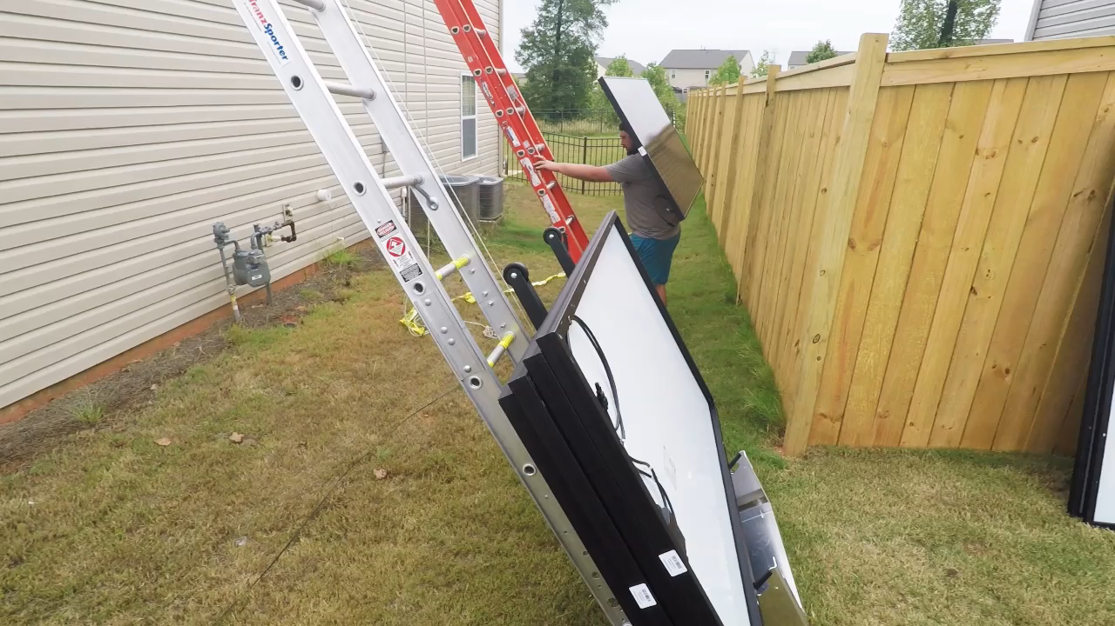
Original tranzvolt

Slide 5



Three major improvements
Reduce Deadload
Emergency System
Simple
U.I.
98 lbs.

Slide 6
Main Desired functions
Quickly and efficiently bring materials up to a roof for easy load/unload
Support and secure a payload of at least 275lbs
Access a variety of roof heights, minimum 32 ft
Emergency system to ensure safety of payload and users if rope breaks
The entire system is easy to transport and set up
The user-interface is easy to learn and to use

Slide 7
Impacts on design

Slide 8
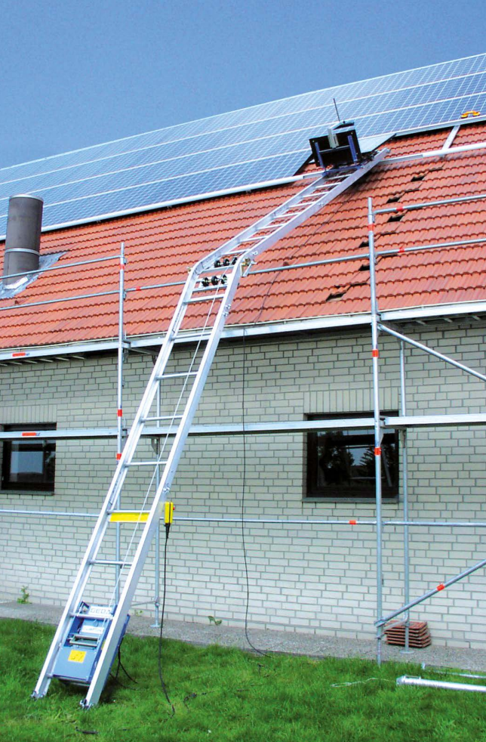
Existing products
Main Competitor: GEDA Solarlift
$3000-$4000 wholesale
Pros:
Safer than gas powered alternatives
Quiet
Quick ROI compared to Boom truck, crane etc.
Cons:
Too much training required
Setup time is too long, averaging 15 minutes
Cable needs too much maintenance – replacements, ensure level-wind, sensitive to fraying etc.

Slide 9
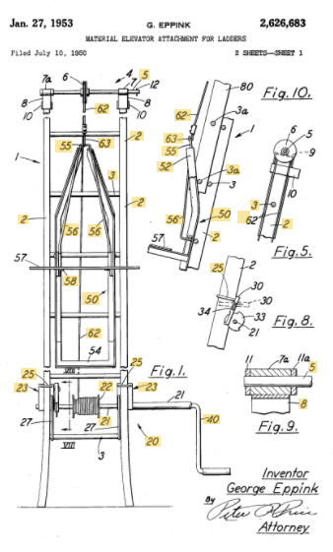
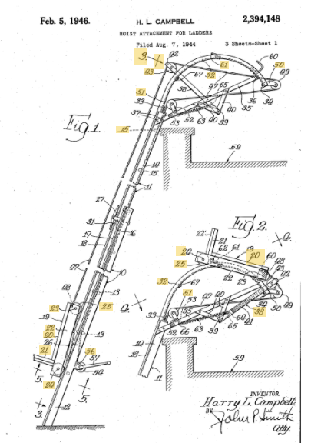
Prior art
Notes:
Here are two separate examples of prior art, but they both have a defining downside: they are both human powered. These prior designs both include pulleys as well as levers to provide the lifting force for the platform. Also, they both rely on ropes without any failsafe mechanism for a rope failure. One important aspect to note is that the design on the right includes a top portion to allow easy removal of the payload once it is up on the roof.

Slide 10
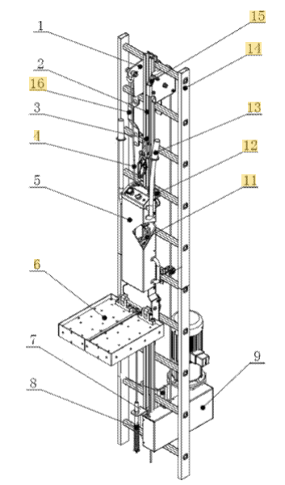
Patents
Hoisting device for working in heights (US10415309B2)
Load and speed not stated
Dependent on traction rope with electric motor separate from the platform
Controlled by collapsible pedal connected to the platform to carry goods/people
Length not specified
Has a guide rail so that the assembly can be installed without changing the structure of an original safety ladder
A fall arrester installed on the sliding rail
Seems excessively complicated to set up and tear down

Slide 11
Codes and standards
1C - AIEE Test Code for Evaluation of Systems of Insulating Materials for Random-Wound Electric Machinery
Ensures temperature regulations for electric machines
C2-2017 - 2017 National Electrical Safety Code(R) (NESC(R))
Includes guidance for construction applications
27A-1941 - AIEE Switchgear Assemblies
Standards for controls and interrupting devices with associated supporting structures
4-2013 - IEEE Standard for High-Voltage Testing Techniques
Codes for proper testing and measurement of uncertainty of high-voltage systems

Slide 12
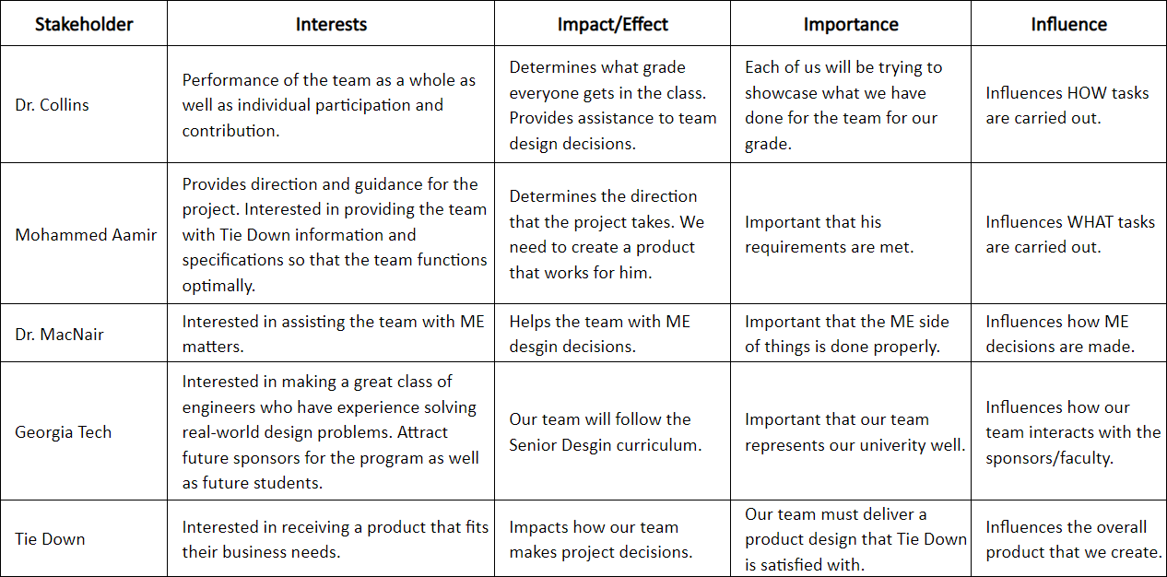
Stakeholder MATRIX

Slide 13
Design planning

Slide 14
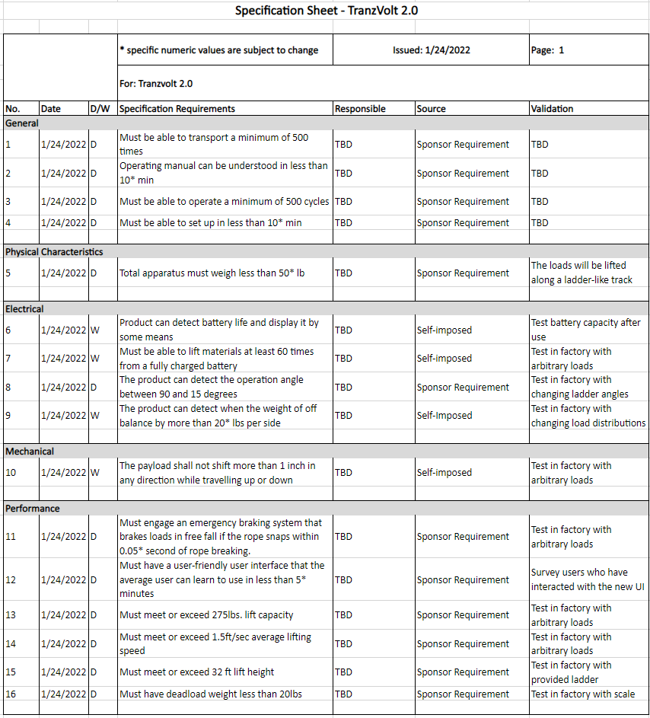
Requirements and specifications
Main requirements:
Total apparatus must weigh less than 50 lb
Must meet or exceed 1.5ft/sec average lifting speed
Must have a deadload weight less than 20 lb
Must meet or exceed 275 lb lift capacity
Setup must take less than 10 minutes

Slide 15
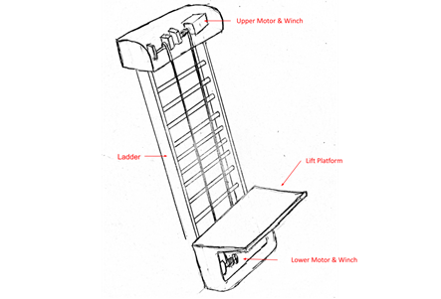
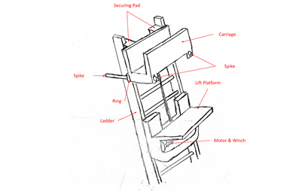
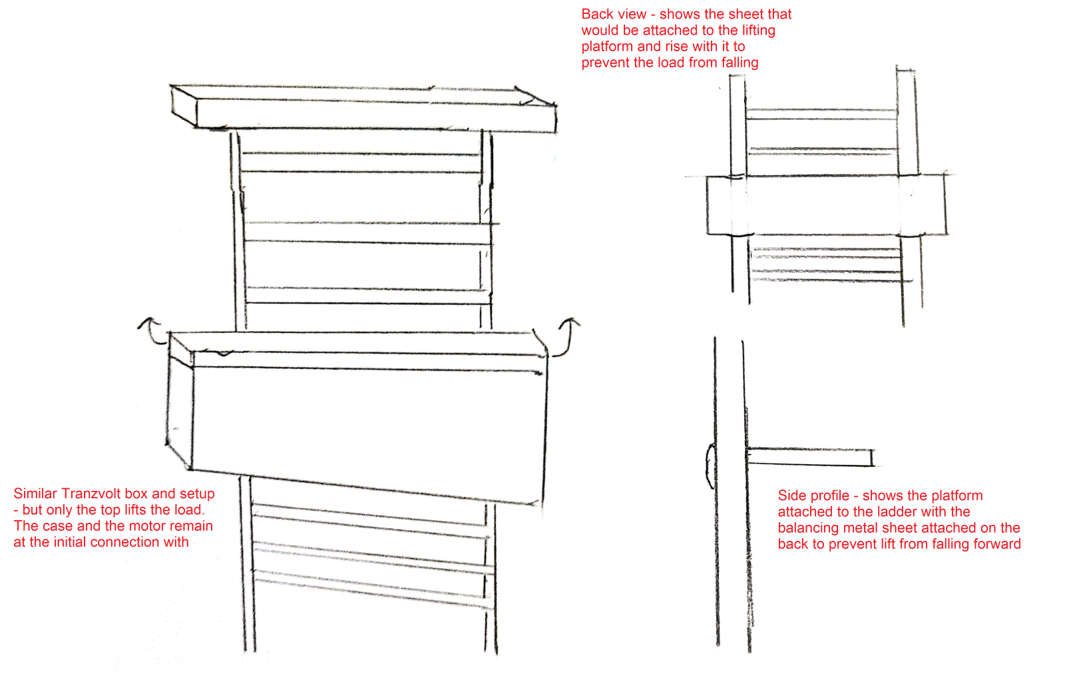
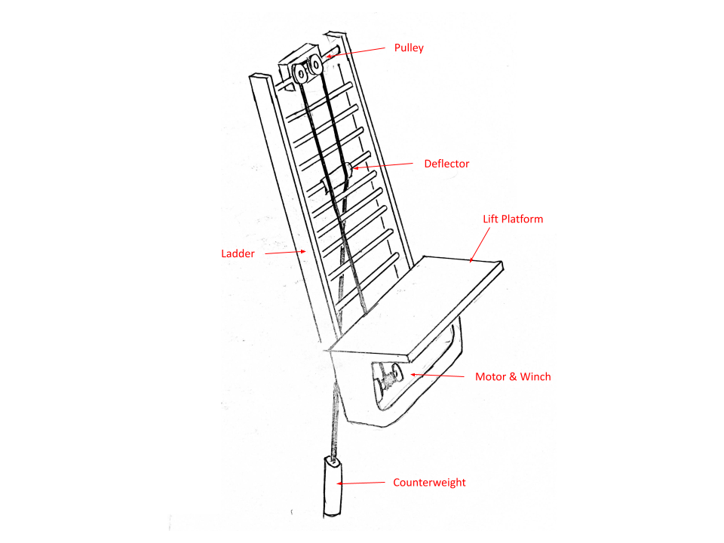
Design ideation
Idea 1: Dual Motors
Double lift
Fail-proof
Longer setup time
Price
No deadload reduction
Idea 2: Detachable Carriage
Decrease deadweight
Increases load potential/speed
Mildly complicates controls
Idea 3: Tranzvolt Remodel
Decrease deadweight
Maintain familiarity with the current market
Idea 4: Counterweight
Faster ascent/slower descent
Extended battery life
Longer setup
Increased risk

Slide 16
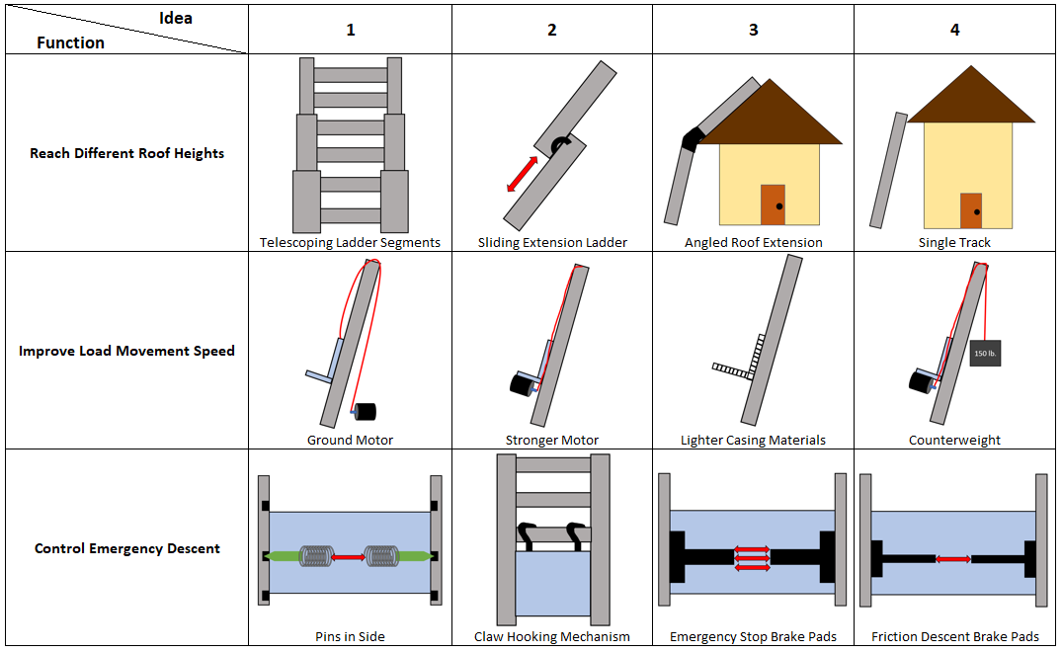
Preliminary design selection

Slide 17
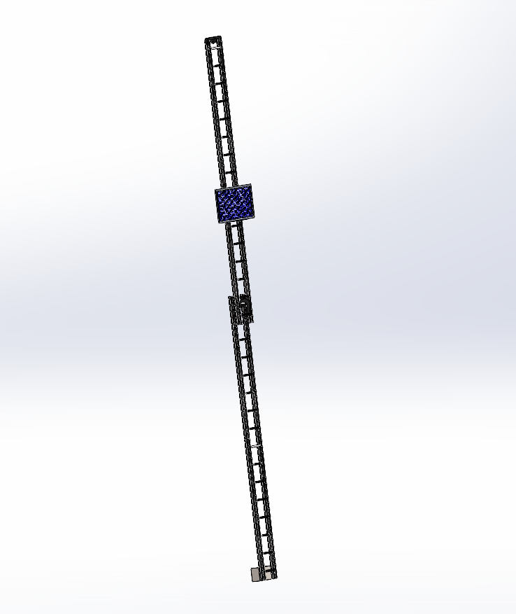
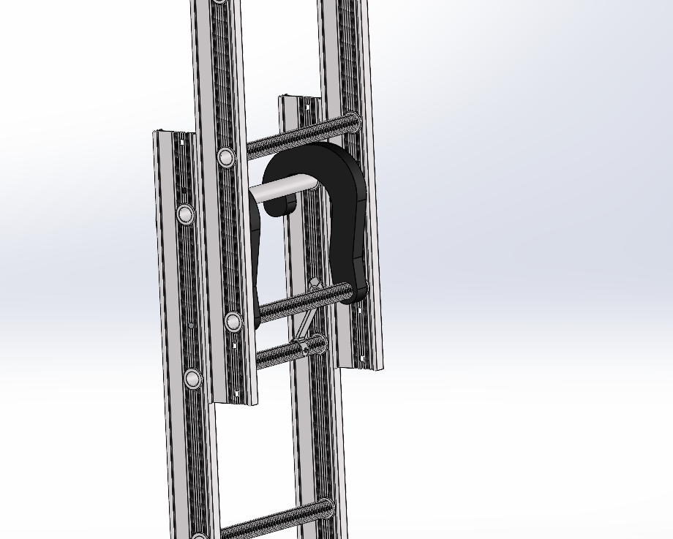
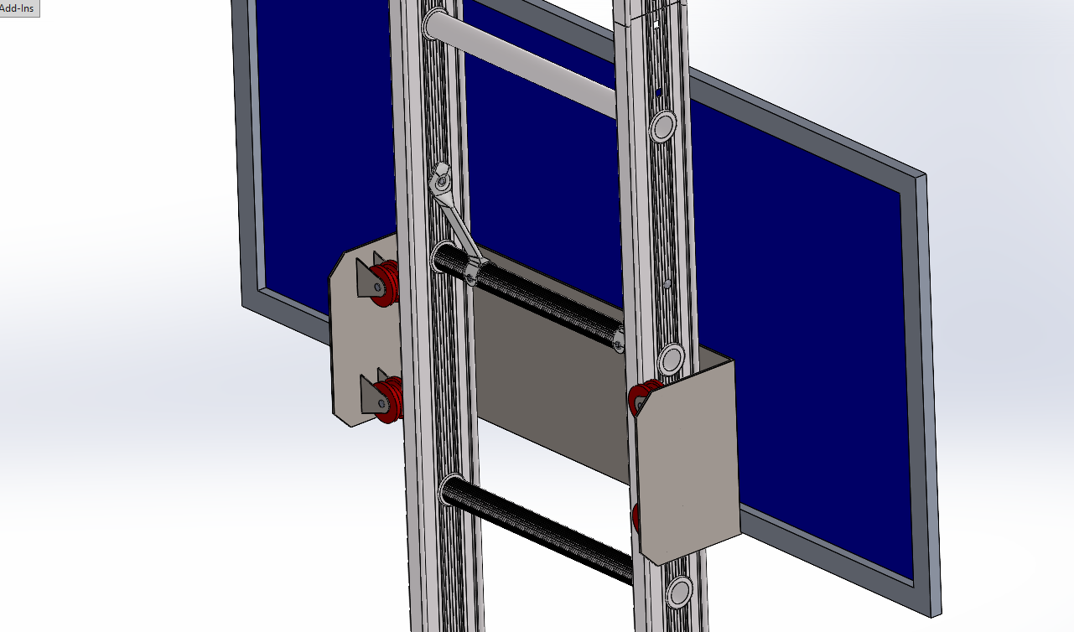
Preliminary design selection

Slide 18
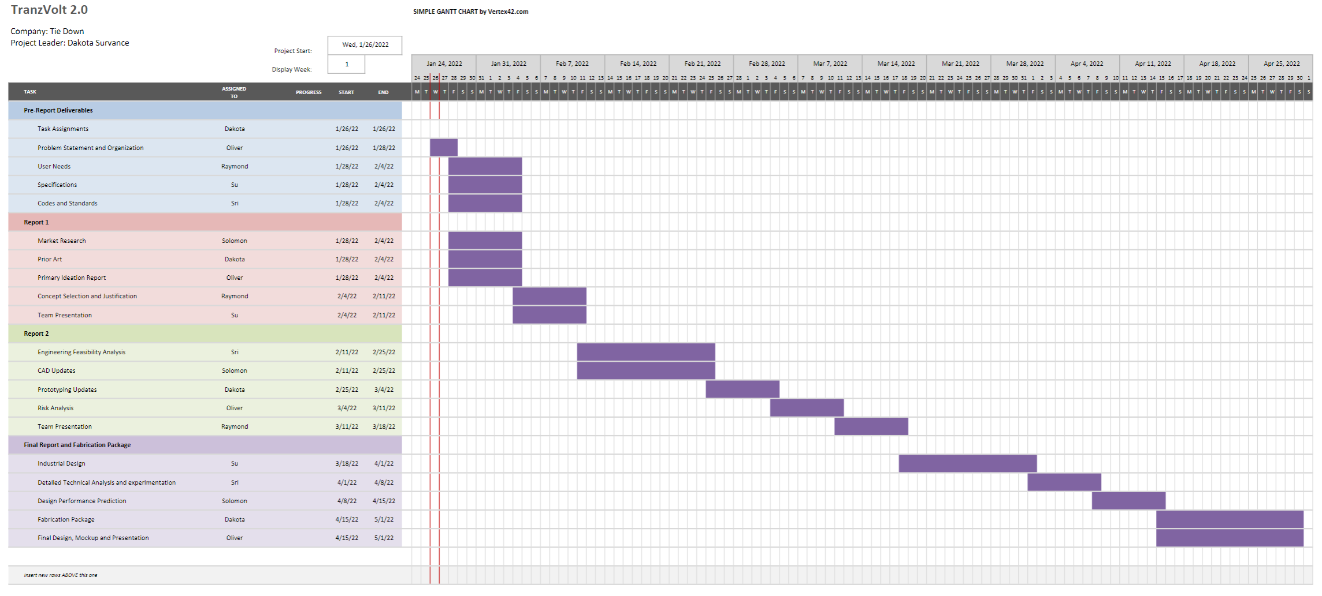
Future work

Slide 19

Thank You

